Slide 1
Wednesday, November 2, 2016
Write In Your Agenda:
Write In Your Monitoring Log:
CW:
Volcano Webquest
Finish Volcano Power Point and Notes
HW:
Study for Earthquake Quiz on Thursday
Response to Warm-Up:
Describe FULLY one aspect of volcanoes you are looking forward to learning about.
You will need:
Pencil
Volcanoes note sheet

Slide 2
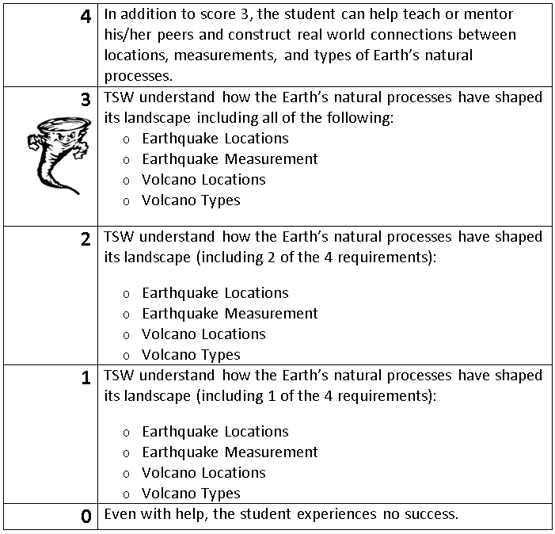
Learning Goal and Scale
TSW understand how the Earth’s natural processes have shaped its landscape (including Earthquake locations and how they are measured as well as Volcano locations and the three types).

